Slide 1
Surface reconstruction from models for subtractive manufacturing simulation
Bernhard Manfred Gruber

Slide 2
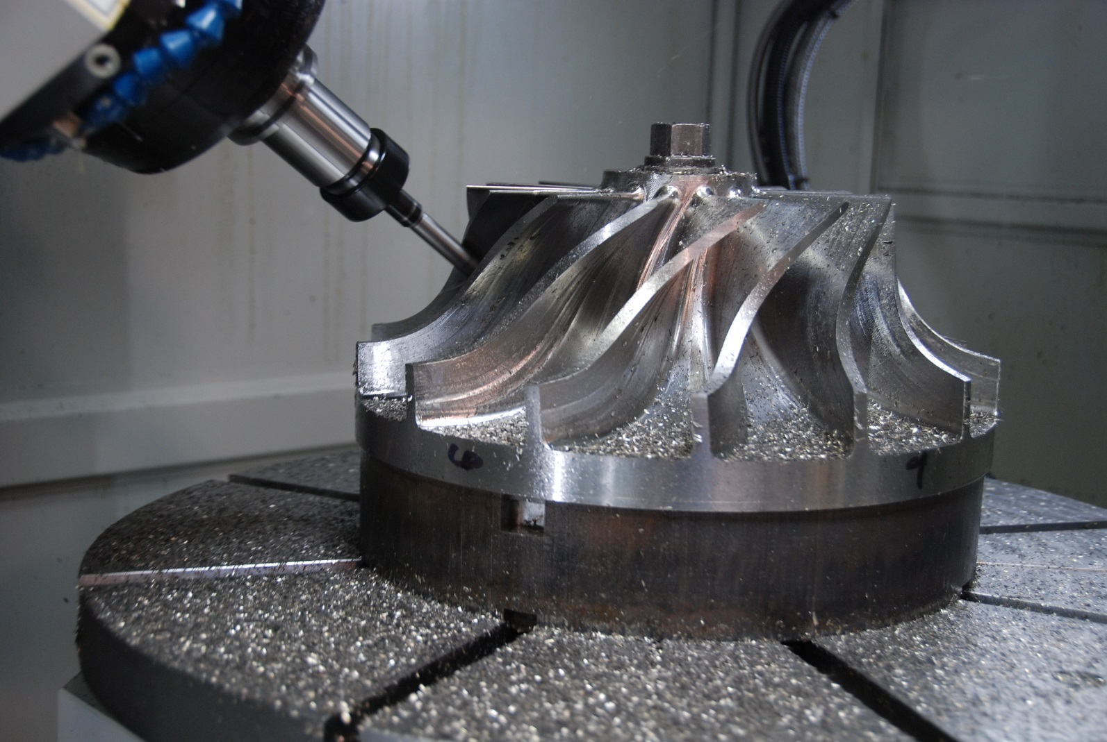
Subtractive manufacturing
http://www.hurco.com/IN/why-hurco/success-stories/blog/PublishingImages/nuconvmx42sr%20cutting.JPG

Slide 3
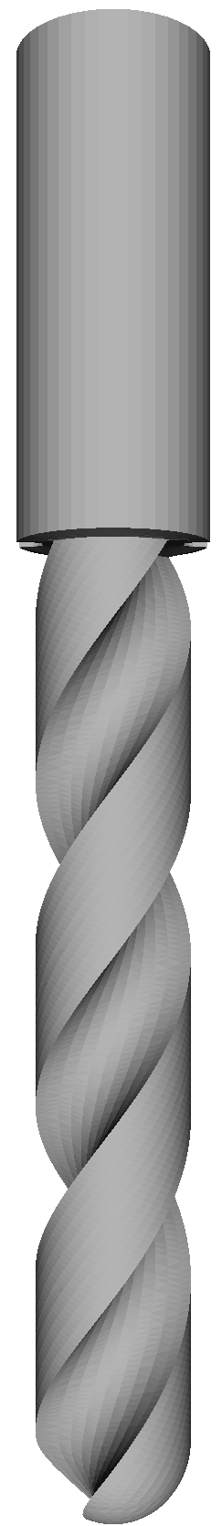
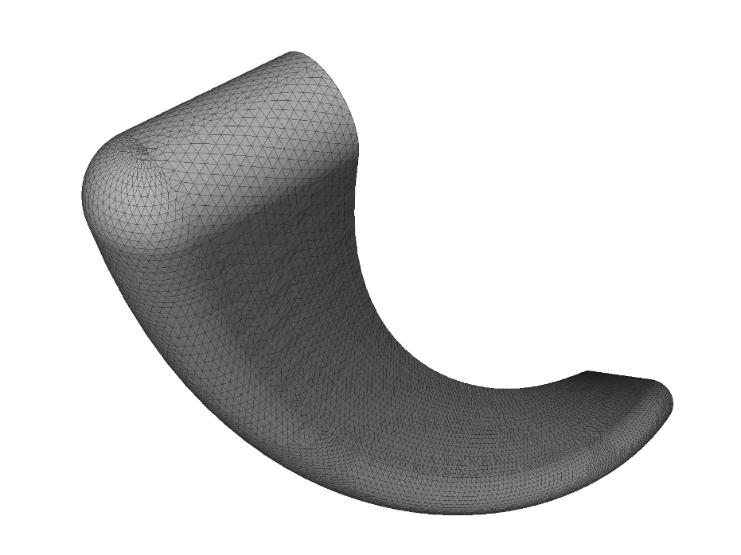
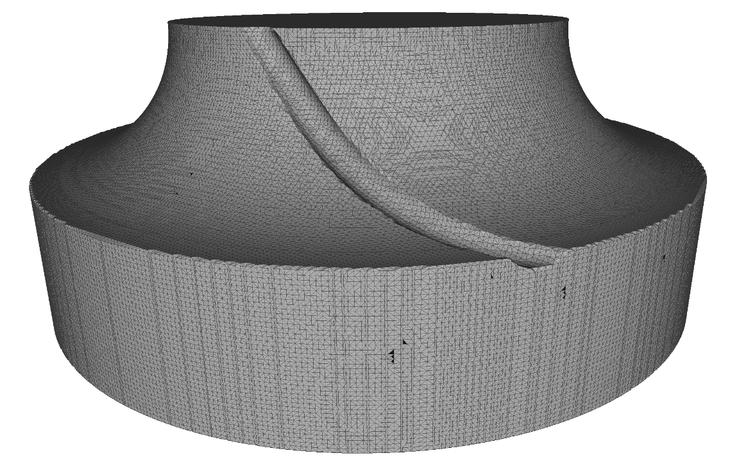
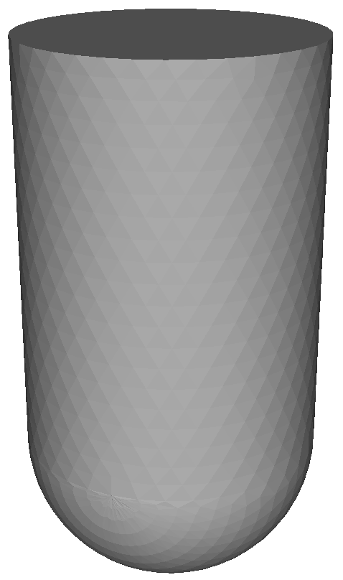
Subtractive manufacturing simulation

Slide 4




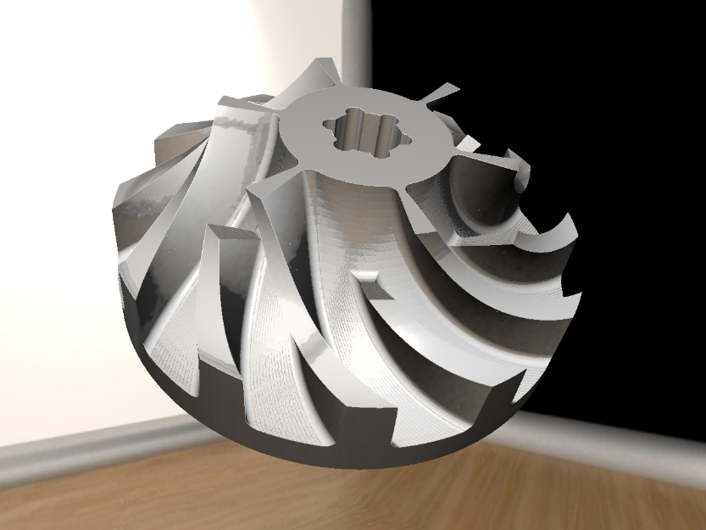
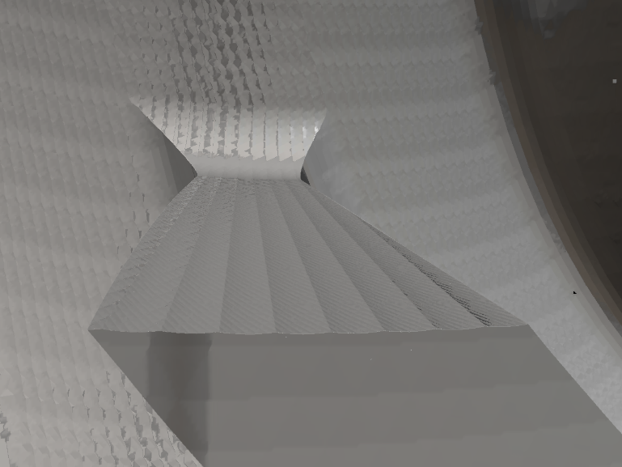
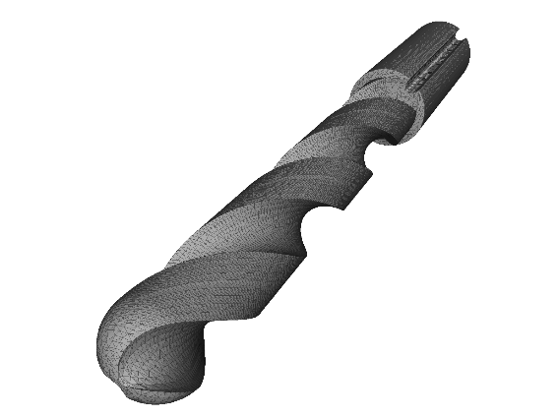
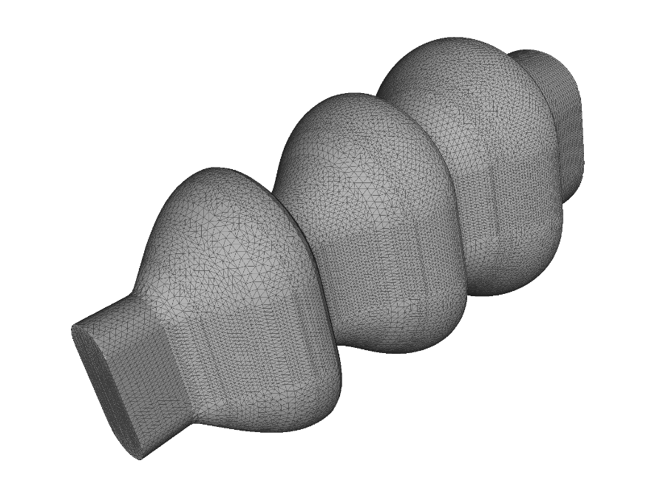
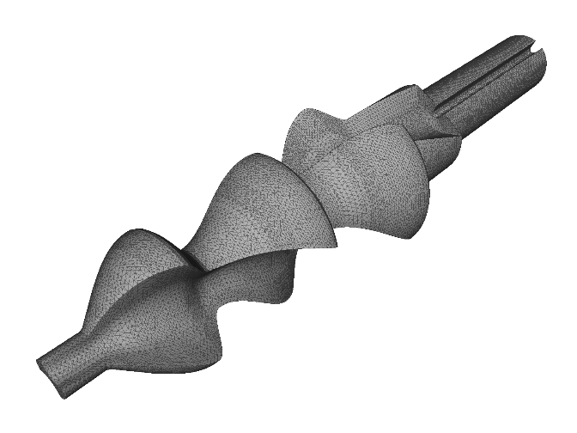
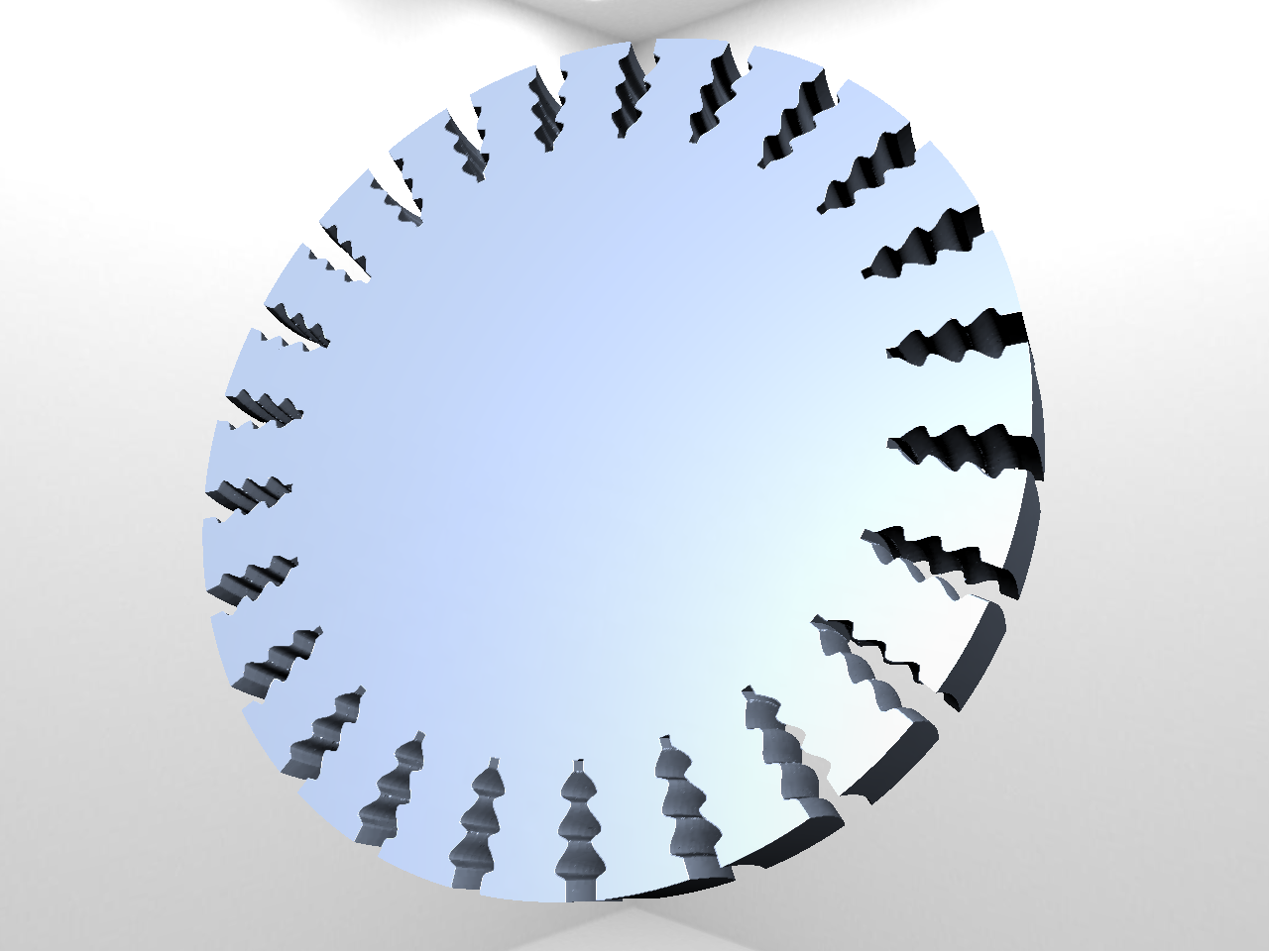
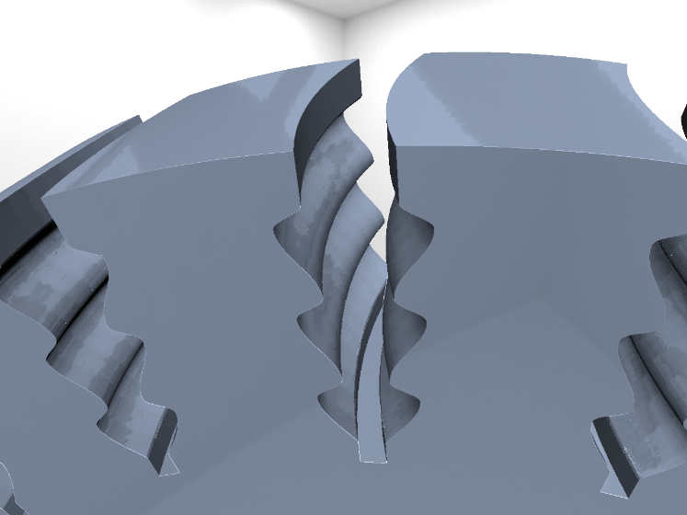
Previous work – VML

Slide 5
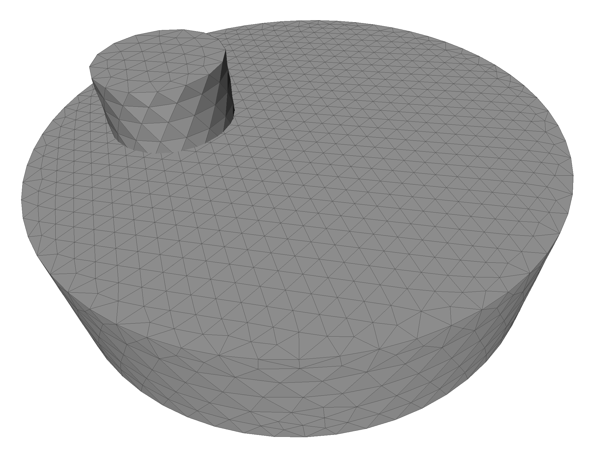
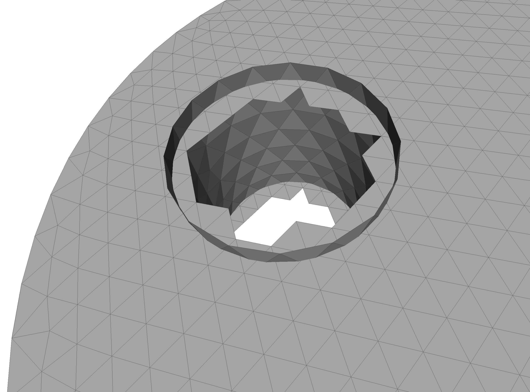
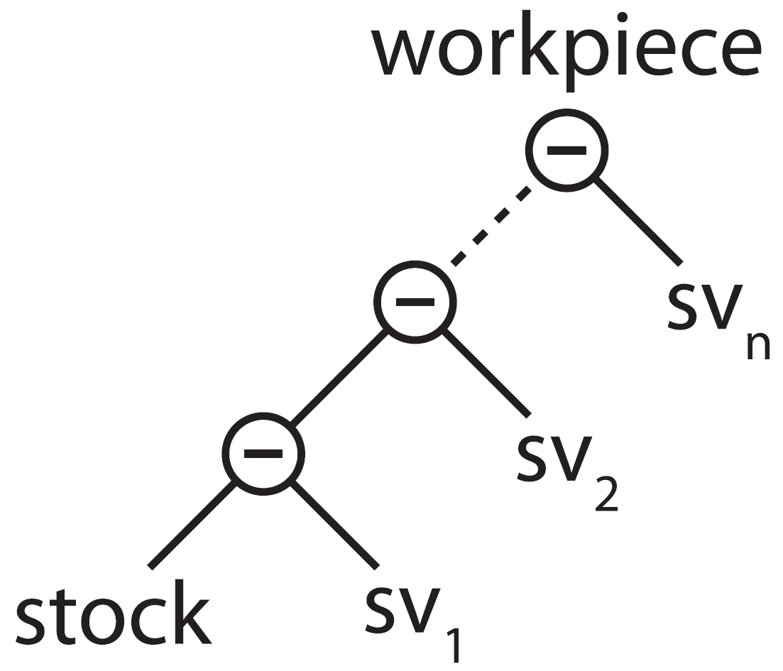
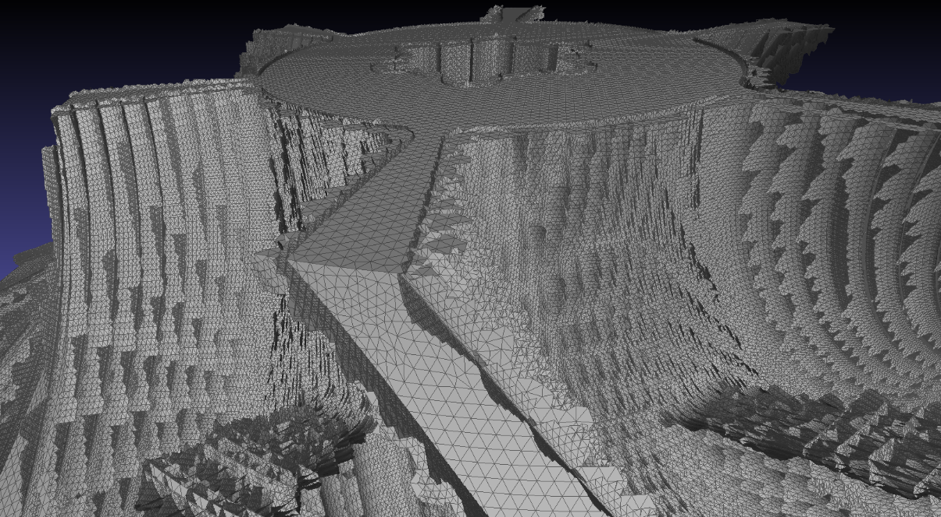
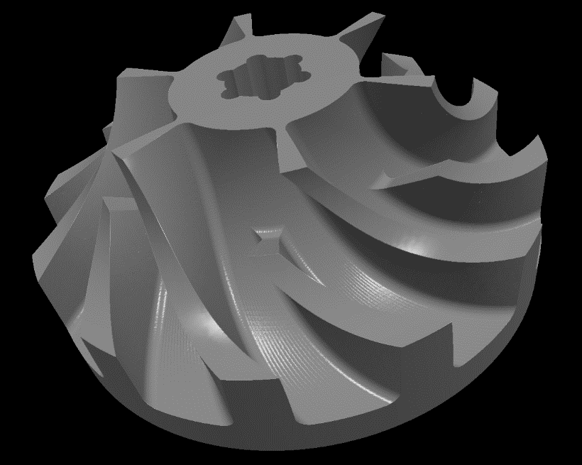
VML data model

Slide 6
Problem statement
Extract triangulated surface from VML data model
Determine state of the art
Prototypic implementation and comparison
runtime, memory, complexity, visual quality, errors, divergence, numeric, mesh quality, feature conservation, adaptivity
Testing on selected scenes
Is there a "best" algorithm? Under which circumstances? How to select best suited algorithm?

Slide 7
Approaches
Direct intersection of swept volumes
Most naïve, theoretically most accurate
Point cloud based
Point cloud easy to create using raycast
Reconstruction already implemented in swept volume computation
Dexel based
Dexel images easy to create using raycast
Implicit function and voxel based
VML already uses a voxel grid

Slide 8
State of the art

Slide 9
Direct intersection
David Rosen, Seamless Intersection Between Triangle Meshes, 2008

Slide 10
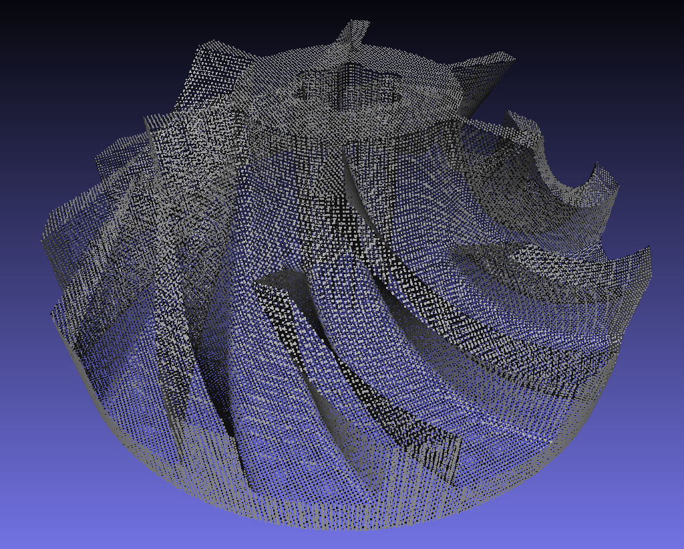
Point cloud based
α-shapes
Delaunay and Voronoi:
Crust and powercrust
Cocone, tight cocone and robust cocone
Region growing:
BPA, G2S
Notes:
A vast amount of algortihms available.
Point cloud reconstruction is a huge topic:
e.g. laser scans of sculptures or building

Slide 11
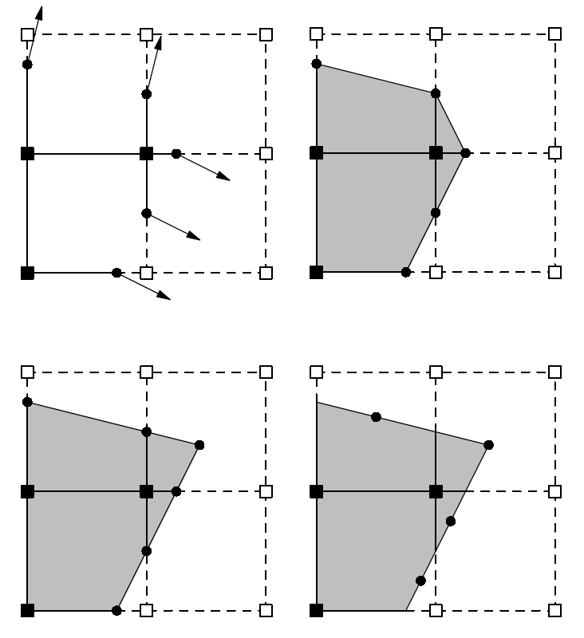
Implicit function and voxel based
Describe surface by a function, sampled at a regular grid
SDF, Hoppe, Poisson, MLS, RBF
Leif Kobbelt et al., Feature sensitive surface extraction from volume data, 2001
Tao Ju et al., Dual contouring of hermite data, 2002

Slide 12
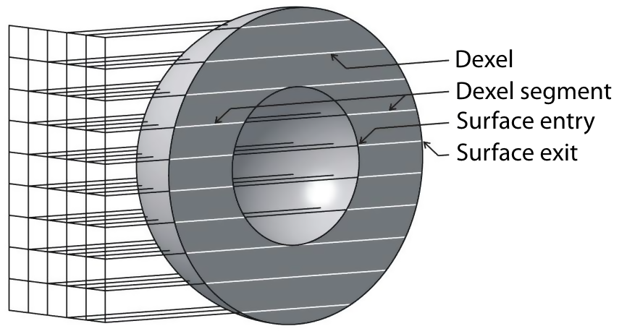
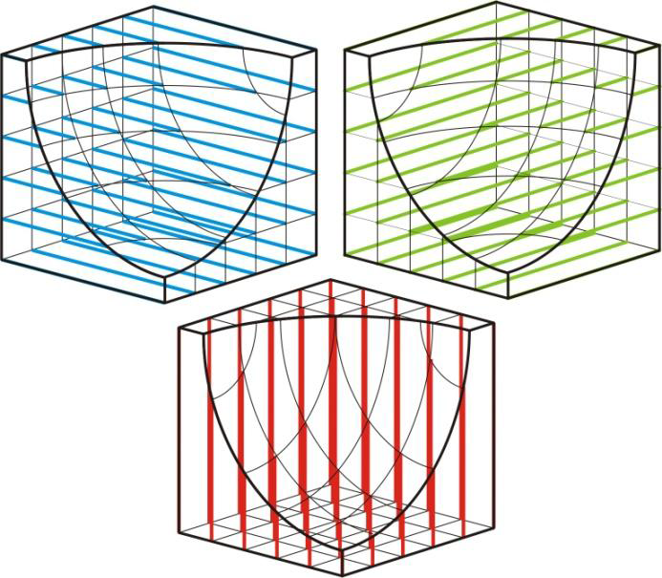
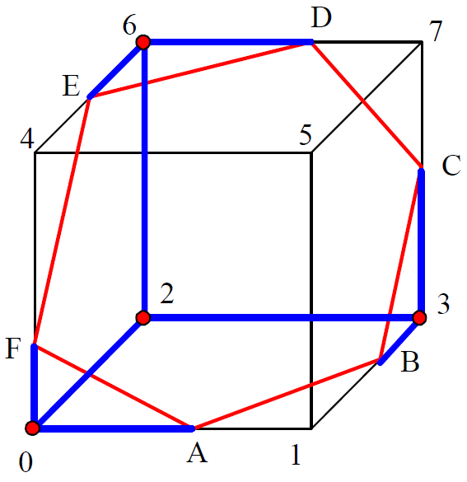
Dexel based
Yongfu Ren et al., Feature conservation and conversion of Tri-dexel volumetric models to polyhedral surface models for product prototyping, 2008

Slide 13
Implementations

Slide 14
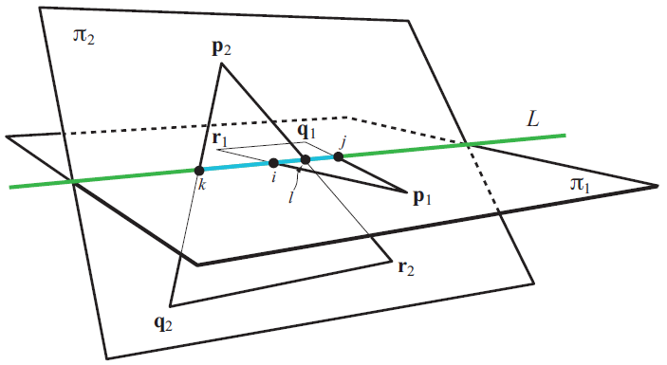
Direct triangle triangle intersection
Tomas Möller, A fast triangle-triangle intersection test, 1997
http://lib.znate.ru/docs/index-40240.html?page=3

Slide 15
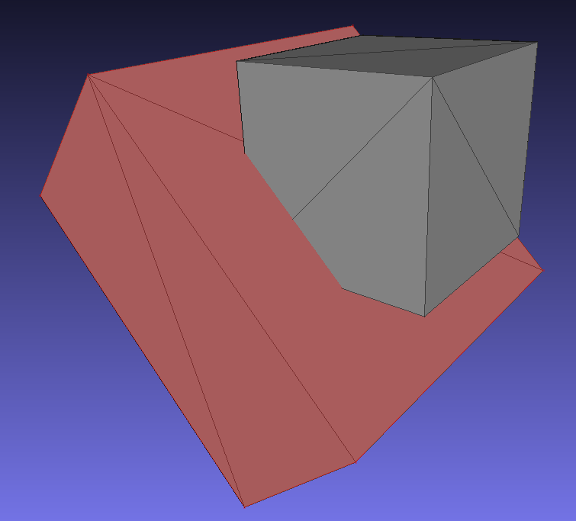
Cube vs. cube

Slide 16
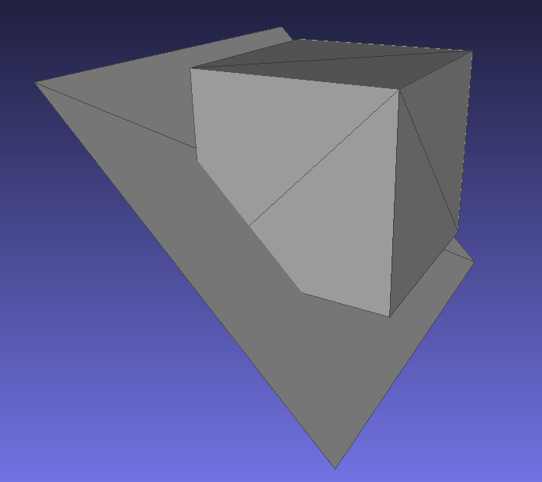
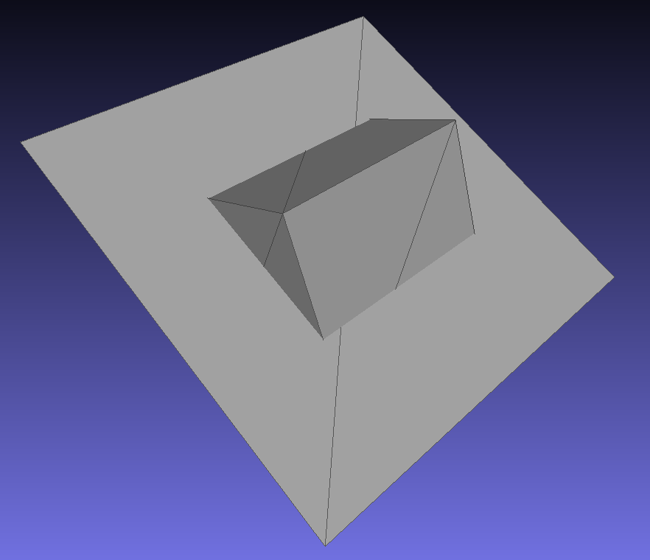
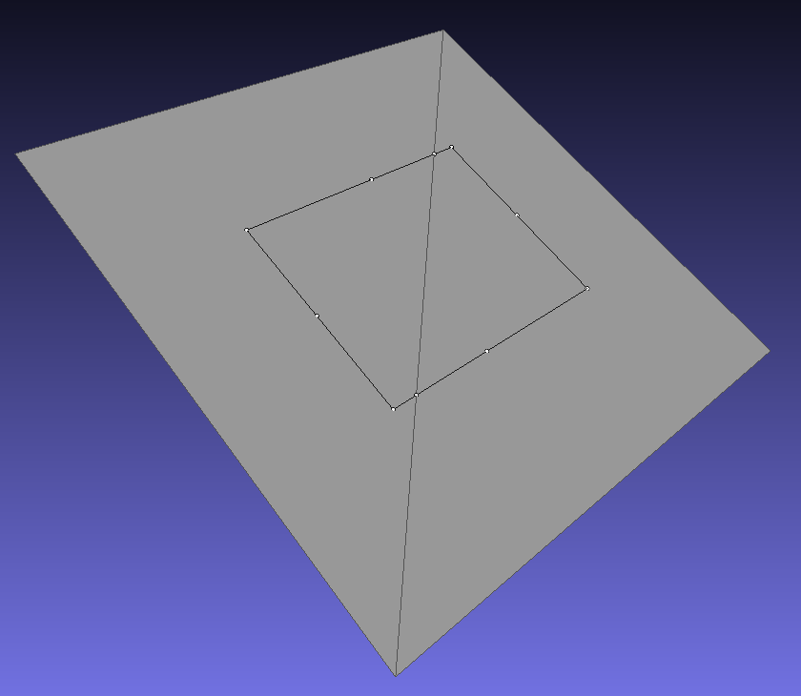
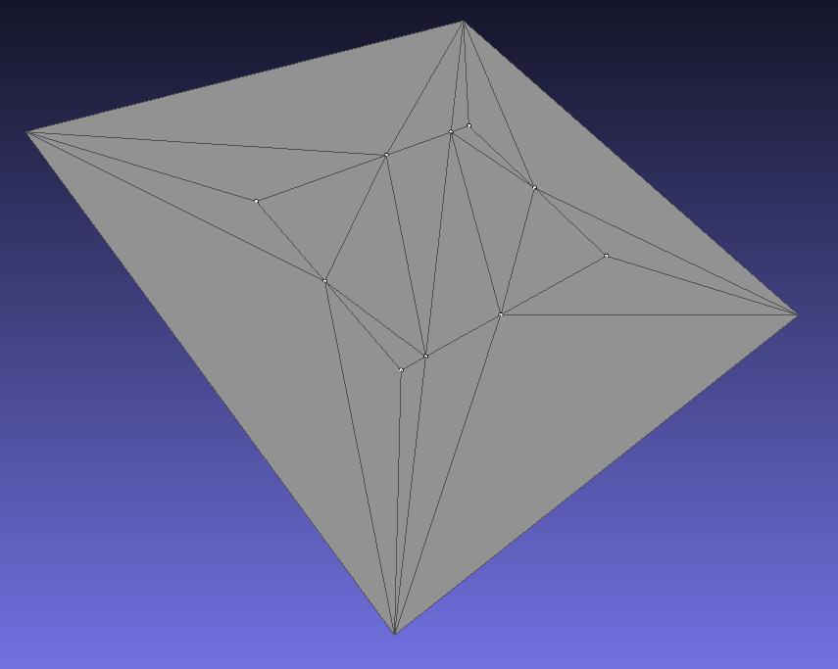
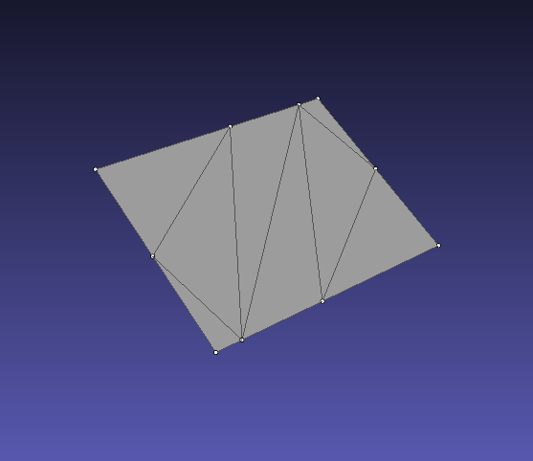
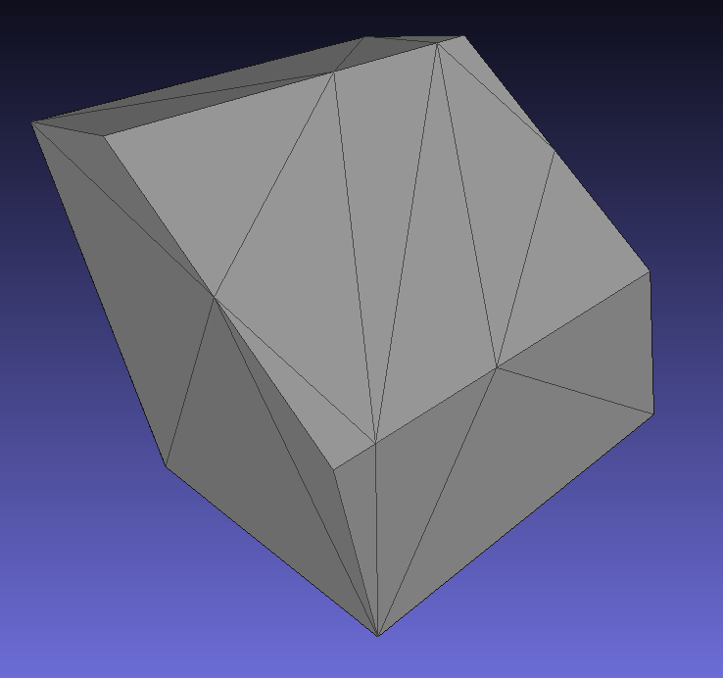

Slide 17
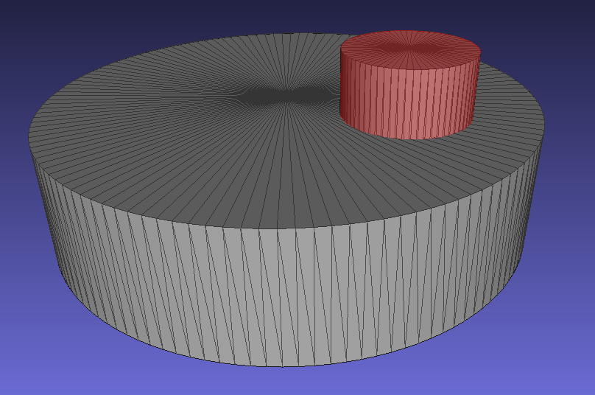
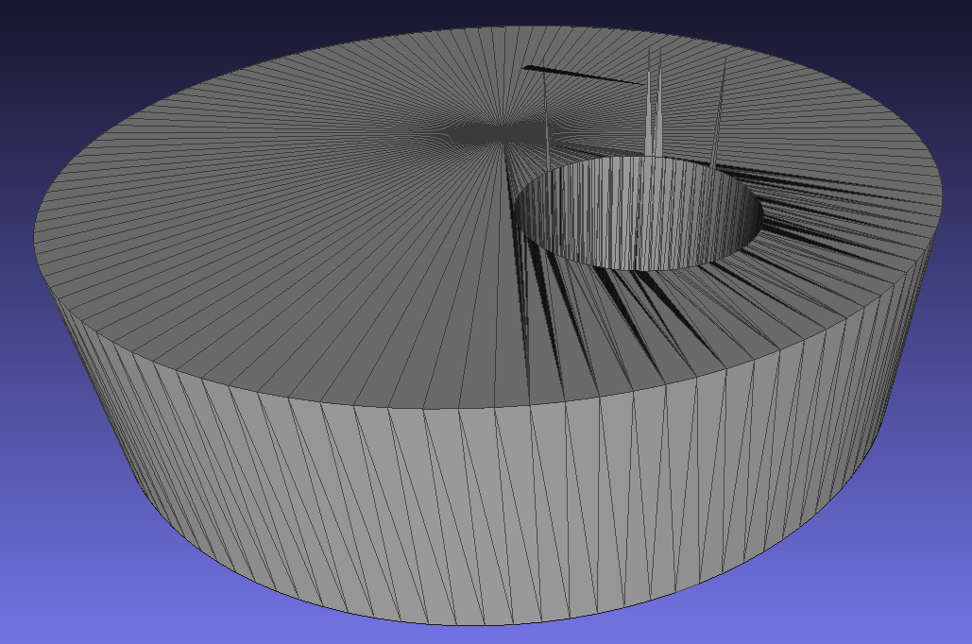
Cylinder vs. cylinder

Slide 18
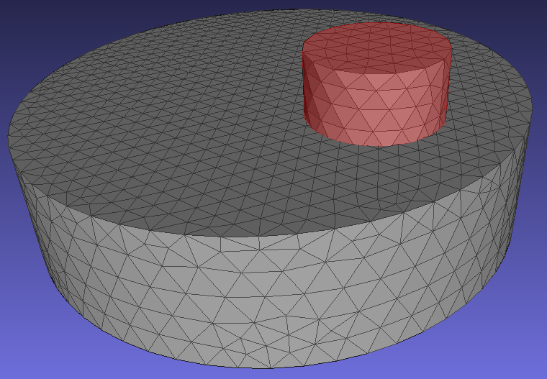
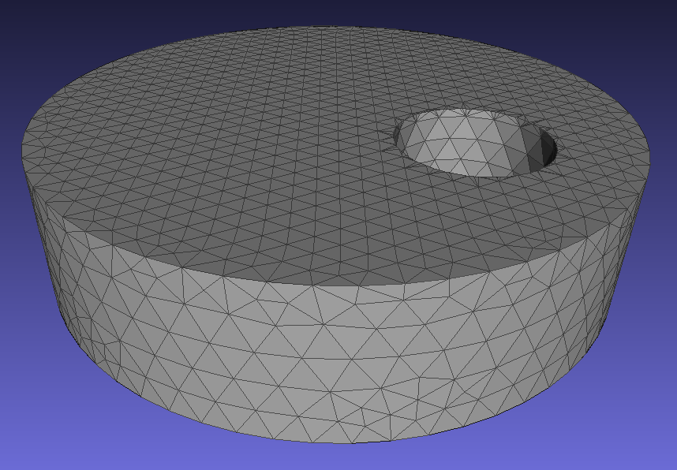
Cylinder vs. cylinder - Delaunay

Slide 19
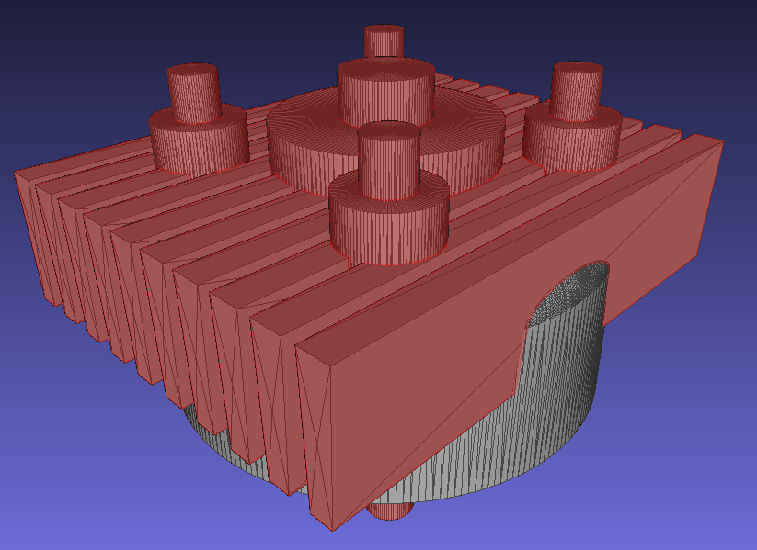
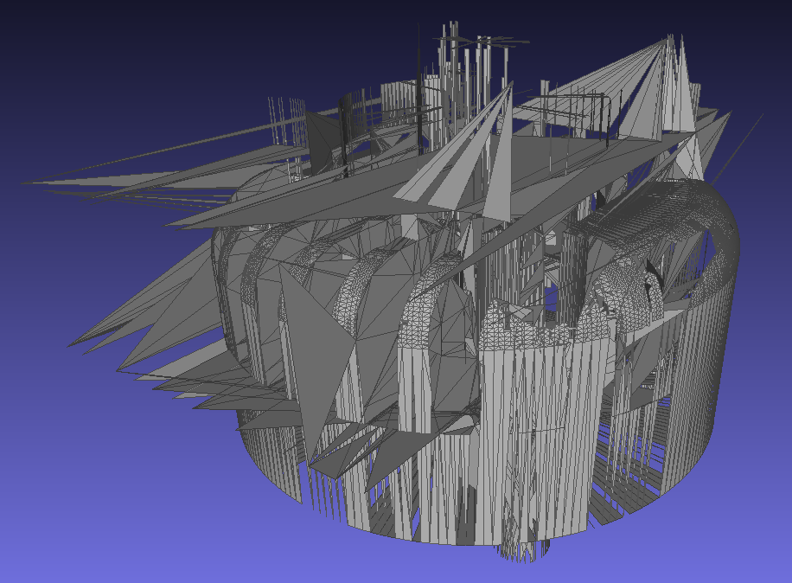
Cylinder head

Slide 20
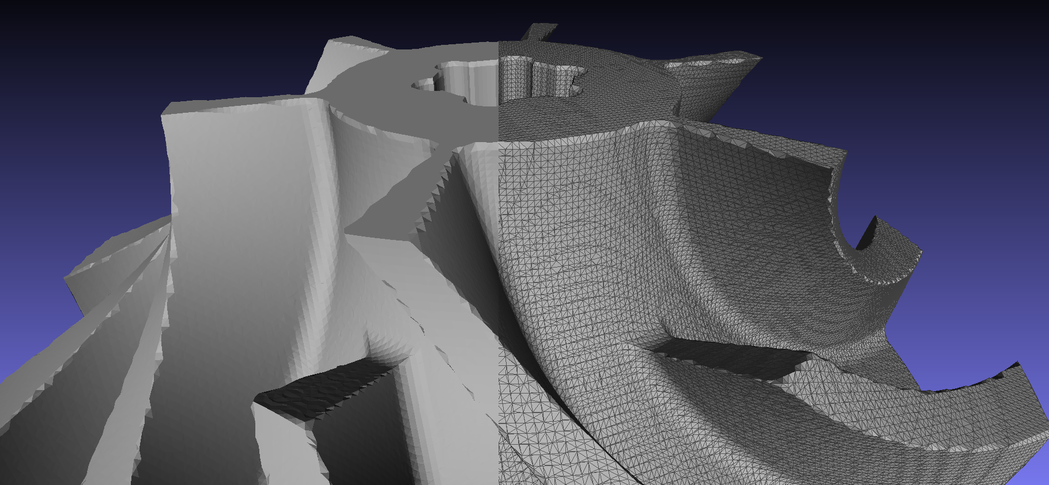
Ball pivoting algorithm

Slide 24
Thank you!
Questions?

